Slide 1
INHERITANCE

Slide 2
Introduction
Reusability--building new components by utilizing existing components- is yet another important aspect of OO paradigm.
It is always good/ “productive” if we are able to reuse something that is already exists rather than creating the same all over again.
This is achieve by creating new classes, reusing the properties of existing classes.
It saves time etc.
This mechanism of deriving a new class from existing/old class is called “inheritance”.
The old class is known as “base” class, “super” class or “parent” class”.
The new class is known as “sub” class “derived” class, or “child” class.

Slide 3
Types of Inheritance
Single Inheritance(One base and one derived class)
Multiple Inheritance(More than one base classes for one derived class)
Hierarchical Inheritance(More than one derived classes for one base class)
Multilevel Inheritance
Hybrid Inheritance(Combination of more than one types of inheritance)

Slide 4
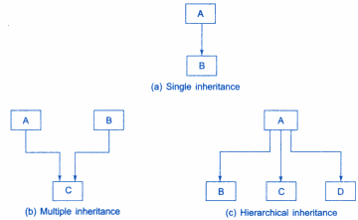

Slide 5
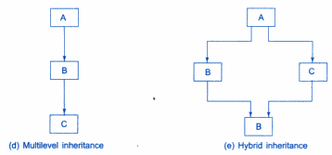

Slide 6
Access specifiers/Visibility modes/Visibility labels in C++
private: private members are accessible inside the same class in which they are defined.
protected: protected members are accessible inside base and derived class only.
public: public members are accessible everywhere.

Slide 7
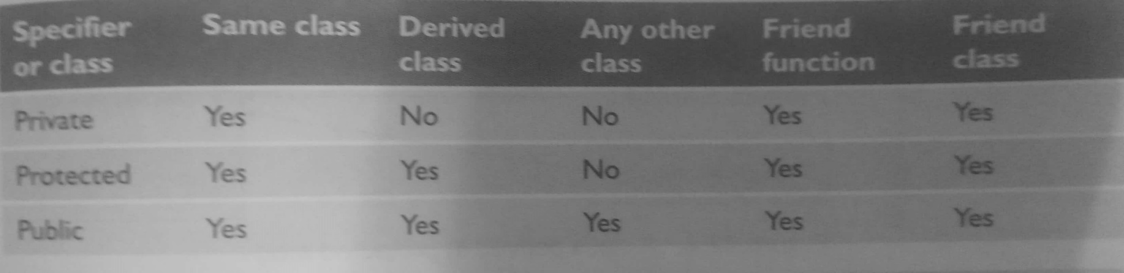
Accessibility areas

Slide 8
Modes of Inheritance/ or Derivation modes
Private mode
Public mode
Protected mode

Slide 9

Private mode

Slide 10
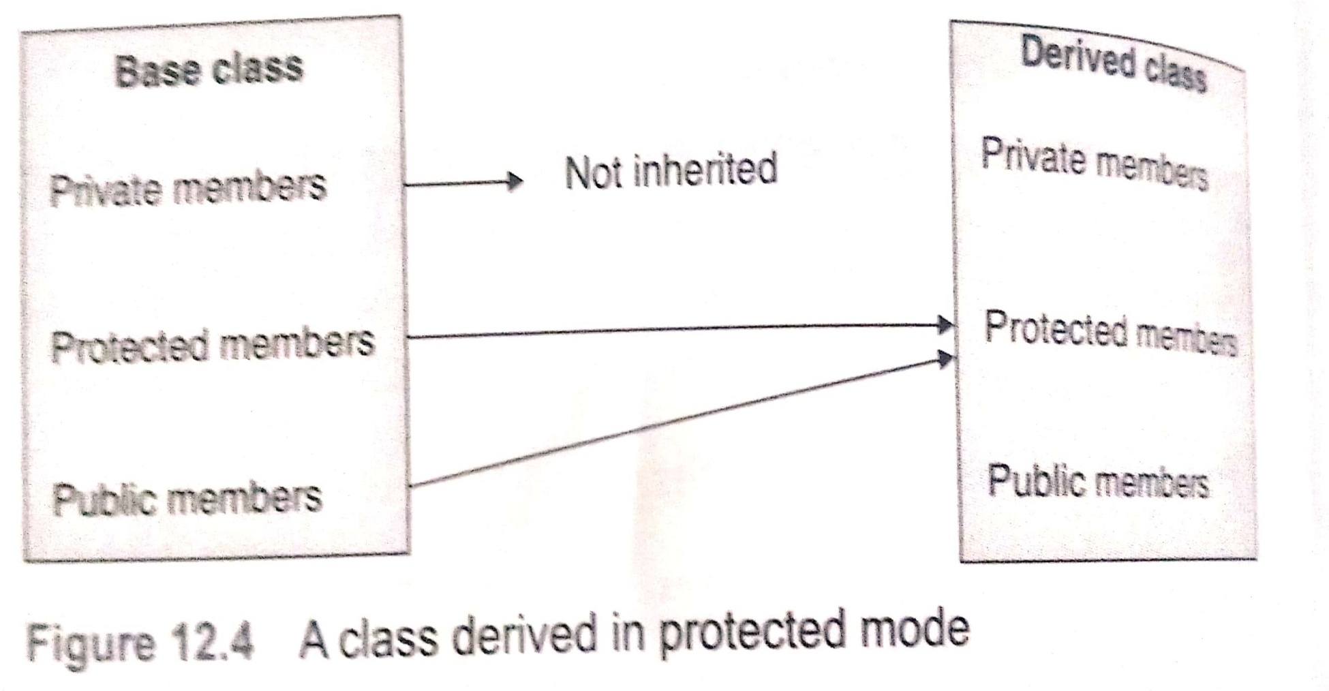
Protected mode

Slide 11
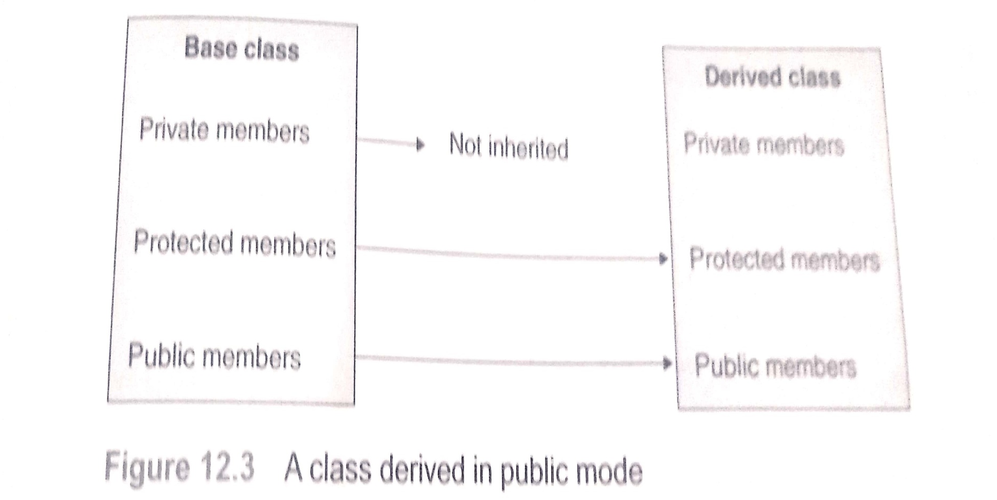
Public mode

Slide 12
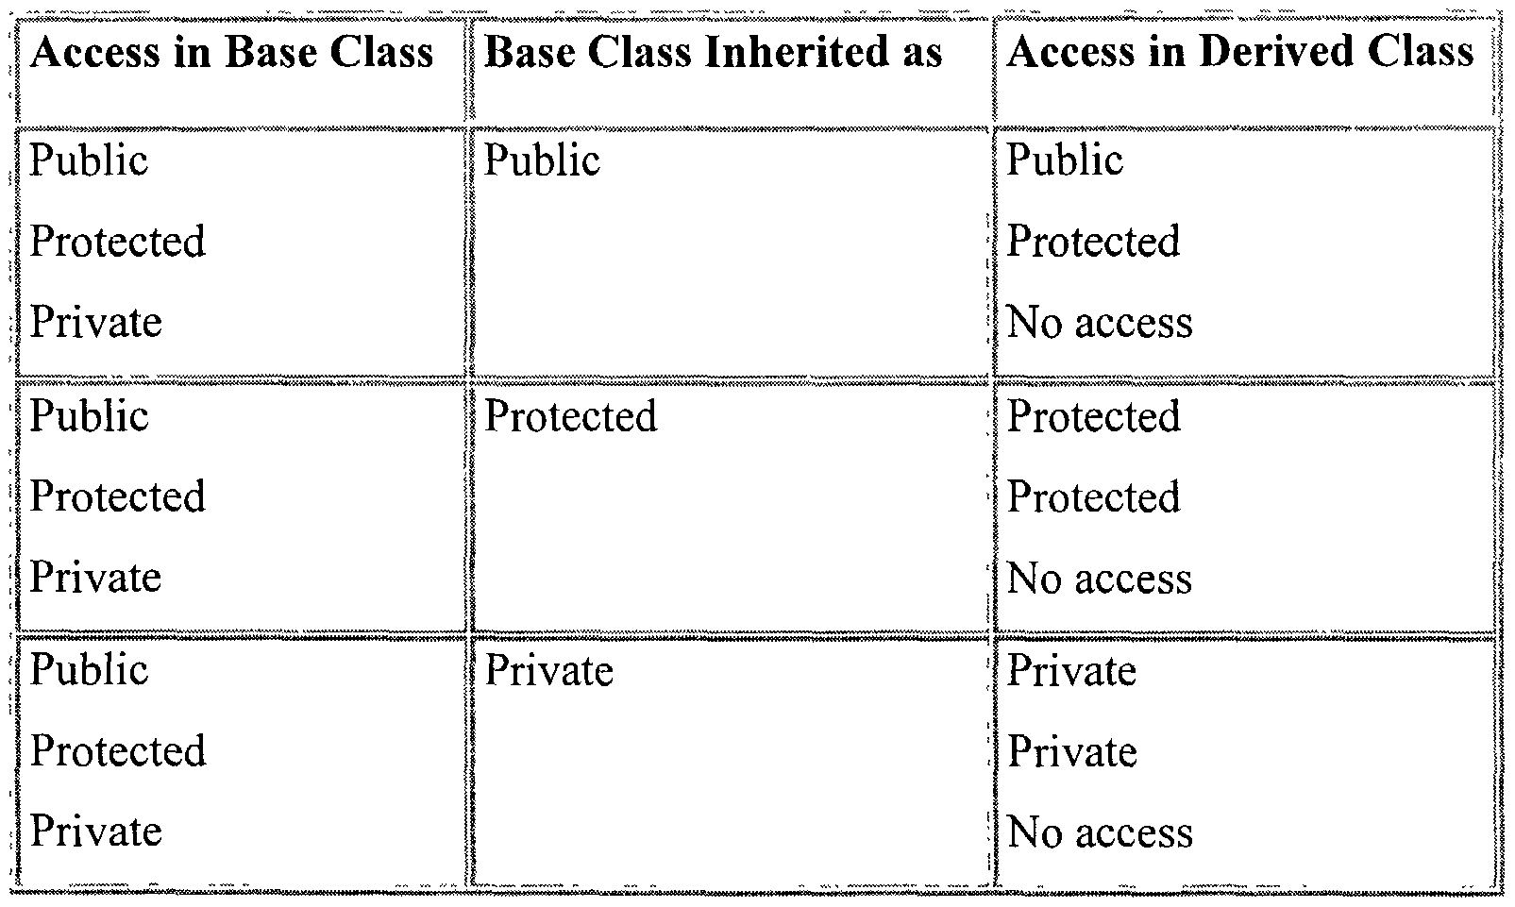
Summary of modes

Slide 13
Summary of modes
Derivation Mode of Inheritance
 | private | protected | public
private | - | - | -
protected | private | protected | protected
public | private | protected | public
Access Control
for Members
The type of inheritance defines the access level for the members of derived class that are inherited from the base class

Slide 14
Defining Derived classes
Syntax:
class DerivedClassName : access-level BaseClassName
where
access-level specifies the type of derivation
private by default, or
Public
Protected
Any class can serve as a base class
Thus a derived class can also be a base class

Slide 15
Implementing Inheritance in C++ by Deriving Classes From the Base Class
Syntax:
class <base_class>
{
…
};
class <derived_class> : <access-specifier><base_class>
{
...
};

Slide 16
Examples
Class ABC : private XYZ //private derivation
{
Members of ABC
};
Class ABC : public XYZ //public derivation
{
Members of ABC
};
Class ABC : XYZ //private derivation by default
{
Members of ABC
};

Slide 17
Public inheritance
When a base class is publicly inherited, ‘public members’ of the base class become ‘public members’ of the derived class and therefore they are accessible to the objects of the derived class.
Note: private members of the base class are not accessible in the derived class (to preserve encapsulation)

Slide 18
Public derivation
Class base
{ private:
int base_a;
protected:
int base_b;
public:
void base_set();
};
Class derived: public base
{
private: int derived_a;
protected: int derived_b;
public: void derived_set();
};
Class derived: public base
{
private:
int derived_a;
protected:
int base_b;
int derived_b;
public:
void base_set();
void derived_set();
};

Slide 19
Program-public mode of derivation
class result:public student
{
private:
float fees;
public:
void get_data()
{
get_rno();
cout<<"\n Enter fees:";
cin>>fees;
cout<<"\n Enter section:";
cin>>section;
}
void display()
{
show_rno();
cout<<"\n Fees:"<<fees;
cout<<"\n Section:"<<section;
}
} ;
int main()
{
result obj1;
obj1.get_data();
obj1.display();
/*obj1.get_rno();//Possible---Public
obj1.show_rno();//Possible--Public
strcpy(obj1.section,"K17TY");//Not Possible--Protected*/
}
#include<iostream>
#include<string.h>
using namespace std;
class student
{
private:
int roll_no;
protected:
char section[10];
public:
void get_rno()
{
cout<<"\n Enter the roll number:";
cin>>roll_no;
}
void show_rno()
{
cout<<"\n Roll no:"<<roll_no;
}
};

Slide 20
Private inheritance
Public members of base class become private members of derived class
Public and protected members are only available to derived-class member functions - not to a derived object.
They are inaccessible to the objects of the derived class.

Slide 21
Program-private mode of derivation
class result:private student
{
private:
float fees;
public:
void get_data()
{
get_rno();
cout<<"\n Enter fees:";
cin>>fees;
cout<<"\n Enter section:";
cin>>section;
}
void display()
{
show_rno();
cout<<"\n Fees:"<<fees;
cout<<"\n Section:"<<section;
}
} ;
int main()
{
result obj1;
obj1.get_data();
obj1.display();
//obj1.get_rno(); //It not will work-Private data
//obj1.show_rno();//It will not work-Private data
//obj1.roll_no=78;//It will not work(Private data)-Not inherited
//strcpy(obj1.section,"K17MM");//It will not work(Private data)
}
#include<iostream>
#include<string.h>
using namespace std;
class student
{
private:
int roll_no;
protected:
char section[10];
public:
void get_rno()
{
cout<<"\n Enter the roll number:";
cin>>roll_no;
}
void show_rno()
{
cout<<"\n Roll no:"<<roll_no;
}
};

Slide 22
Private derivation
Class base
{
private:
int base_a;
protected:
int base_b;
public:
void base_set();
};
Class derived: private base
{
private: int derived_a;
protected: int derived_b;
public: void derived_set();
};
Class derived: protected base
{
private:
int derived_a;
int base_b;
void base_set();
protected:
int derived_b;
public:
void derived_set();
};

Slide 23
Protected inheritance
A member declared as protected is accessible by the member functions within its class and any class immediately derived from it.
It cannot be accessed by the functions outside these two classes.
It is possible to inherit a base class in protected mode. In this, Public and protected members of the base class become protected members of the derived class.

Slide 24
Protected derivation
Class base
{
private:
int base_a;
protected:
int base_b;
public:
void base_set();
};
Class derived: protected base
{
private: int derived_a;
protected: int derived_b;
public: void derived_set();
};
Class derived: protected base
{
private:
int derived_a;
protected:
int base_b;
int derived_b;
void base_set();
public:
void derived_set();
};

Slide 25
Program-protected mode of derivation
class result:protected student
{
private:
float fees;
public:
void get_data()
{
get_rno();
cout<<"\n Enter fees:";
cin>>fees;
cout<<"\n Enter section:";
cin>>section;
}
void display()
{
show_rno();
cout<<"\n Fees:"<<fees;
cout<<"\n Section:"<<section;
}
} ;
int main()
{
result obj1;
obj1.get_data();
obj1.display();
//obj1.get_rno(); //It will not work
//obj1.show_rno();//It will not work
//obj1.roll_no=78;//It will not work(Private data)
//strcpy(obj1.section,"K17MM");//It will not work(Protected data)
}
#include<iostream>
#include<string.h>
using namespace std;
class student
{
private:
int roll_no;
protected:
char section[10];
public:
void get_rno()
{
cout<<"\n Enter the roll number:";
cin>>roll_no;
}
void show_rno()
{
cout<<"\n Roll no:"<<roll_no;
}
};

Slide 26
Class B
Private
Protected
Public
Not Inheritable
ClassD2:private B
Class D1:public B
Private
Protected
Public
Private
Protected
Public
Class X:public D1:protected D2
Private
Protected
Public

Slide 27
Understanding Inheritance Restrictions
The following are never inherited:
constructors
destructors
friend functions
overloaded new operators
overloaded = operators
Class friendship is not inherited

Slide 28
Single Inheritance
#include<iostream.h>
class B
{
int a; //private not inheritable
public: //ready for inheritance
int b;
void get_ab();
int get_a();
void show_a();
};
class D:public B //public derivation
{
int c;
public:
void mul(void);
void display(void);
};
void B:: get_ab(void)
{
a=5;b=10;
}

Slide 29
int B::get_a()
{
return a;
}
void B::show_a()
{
cout<<“a=“a<<“\n”;
}
void D::mul()
{
c= b*get_a();
}
void D::display()
{
cout<<“a=“<<get_a()<<“\n”;
cout<<“b=“<<b<<“\n”;
cout<<“c=“<<c<<“\n”;
}
int main()
{
D d;
d.get_ab();
d.mul();
d.show_a();
d.display();
d.b=20;
d.mul();
d.display();
return 0;
}

Slide 30
Single Inheritance
#include<iostream.h>
class B
{
int a; //private not inheritable
public: //ready for inheritance
int b;
void get_ab();
int get_a();
void show_a();
};
class D:private B //private derivation
{
int c;
public:
void mul(void);
void display(void);
};
void B:: get_ab(void)
{
a=5;b=10;
}

Slide 31
int B::get_a()
{
return a;
}
void B::show_a()
{
cout<<“a=“a<<“\n”;
}
void D::mul()
{
get_ab();
c= b*get_a(); //’a’ can’t be used directly
}
void D::display()
{ show_a(); //output ‘a’
cout<<“b=“<<b<<“\n”;
cout<<“c=“<<c<<“\n”;
}
int main()
{
D d;
//d.get_ab(); //won’t work
d.mul();
//d.show_a(); //won’t work
d.display();
//d.b=20; //won’t work
d.mul();
d.display();
return 0;
}

Slide 32
Multiple Inheritance
Is the phenomenon where a class may inherit from two or more classes
Syntax:
class derived : public base1, public base2
{
//Body of class
};
Base classes are separated by comma
A
B
C
Notes:
32

Slide 33
Multiple Inheritance
#include <iostream.h>
class M
{
protected:
int m;
public:
void get_m(int);
};
class N
{
protected:
int n;
public:
void get_n(int);
};
class P:public M, public N
{
public:
void display(void);
};
void M::get_m(int x)
{ m=x;}
void N::get_n(int y)
{ n= y;}
void P::display(void)
{
cout<<“m=“<<m<<“\n”;
cout<<“n=“<<n<<“\n”;
cout<<“m*n=”<<m*n<<“\n”;
}
int main()
{
P p;
p.get_m(10); //m=10
p.get_n(20); //n=20
p.display(); //m*n = 200
return 0;
}

Slide 34
Multilevel Inheritance
It is also possible to derive a class from an existing derived class.
It is implemented by defining atleast three classes.
Each derived class must have a kind of relationship with its immediate base class.
A
B
C

Slide 35
Multilevel Inheritance
class test : public student //first level
{ derivation
protected:
float sub1,sub2;
public:
void get_marks(float,float);
void put_marks(void);
};
void test::get_marks(float x,float y)
{ Sub1=x; sub2=y;}
void test::put_marks()
{ cout<<“Marks in sub1”<<sub1;
cout<<“Marks in sub2”<<sub2;}
class result:public test //second level derivation
{ float total ;
public:
void display(void) ;}
#include <iostream.h>
class student
{
protected:
int roll_no;
public:
void get_no(int);
void put_no(void);
};
void student::get_no(int a)
{ Roll_no=a;}
void student ::put_no()
{ cout<<“Roll number is”<<roll_no;
}

Slide 36
Void result:: display(void)
{
Total= sub1+sub2;
Put_no(); //function of class student
Put_marks(); //function of class test
Cout<<“Total = “<<total;
}
Int main()
{
Result student1;
Student1.get_no(102);
Student1.get_marks(80.0,98.5);
Student1.display();
Return 0;
}

Slide 37
Hierarchical Inheritance
#include<iostream>
using namespace std;
class M
{
protected:
int x;
public:
void set(int a)
{
x=a;
}
};
class N:public M
{ public:
void display()
{
cout<<"\nx:"<<x<<"accessed in Derived Class N";
}
};
class O:public M
{
public:
void display()
{
cout<<"\nx:--"<<x<<"accessed in Derived Class O";
}
};
int main()
{
N obj1;
O obj2;
obj1.set(12);
obj1.display();
obj2.set(19);
obj2.display();
return 0;
}

Slide 38
Hybrid Inheritance
#include<iostream>
using namespace std;
class student
{
protected:
int roll_number;
public:
void get_number(int a)
{
roll_number=a;
}
void put_number()
{
cout<<"Roll No:"<<roll_number<<"\n";
}
};
class test:public student
{
protected:
float part1,part2;
public:
void get_marks(float x,float y)
{
part1=x;
part2=y;
}
void put_marks()
{
cout<<"\n"<<"Part1="<<part1<<"\n"<<"Part2="<<part2<<"\n";
}
};
class sports
{
protected:
float score;
public:
void get_score(float s)
{
score=s;
}
void put_score()
{
cout<<"Sports wt:"<<score<<"\n\n";
}
};
class result:public test,public sports
{
float total;
public:
void display();
};

Slide 39
Hybrid Inheritance continued..
void result::display()
{
total=part1+part2+score;
put_number();
put_marks();
put_score();
cout<<"Total Score:"<<total<<"\n";
}
int main()
{
result student_1;
student_1.get_number(1234);
student_1.get_marks(27.5,33.2);
student_1.get_score(6.6);
student_1.display();
return 0;
}

Slide 40
(Ambiguities during inheritance) Ambiguity in multiple inheritance
When function with same signatures(or prototypes) appear in multiple base classes , then on accessing the same function with the help of the object of derived class, ambiguity may arise, as compiler cannot decide which base class function to call. So ambiguity arises
Can be resolved by accessing the function with class name and scope resolution operator along with the object of derived class
<derived_object>.<base_Class_name>::<function_name>(<parameters if required>);

Slide 41
Program example-Ambiguity and solution[Ambiguity problem in multiple inheritance)
#include<iostream>
using namespace std;
class B1
{
public:
void show_data()
{
cout<<"\n In the Base class 1";
}
};
class B2
{
public:
void show_data()
{
cout<<"\n In the Base class 2";
}
};
class D:public B1,public B2
{
public:
/*void display()
{
//B1::show_data();
//B2::show_data();
}*/
};
int main()
{
D obj;
obj.show_data();//--Ambiguity problem
//Solution
//obj.B1::show_data();
//obj.B2::show_data();
// or
//obj.display();
}

Slide 42
(Ambiguities during inheritance) Ambiguity in hybrid inheritance[or Multipath inheritance]
Also known as diamond problem
Situation may arise when multiple copies of the grandparent’s class member is available in the child via multiple paths offered by parents classes. Hence ambiguity arises
Path 1:B→B1→D
Path 2:B→B2→D
B
B1
B2
D

Slide 43
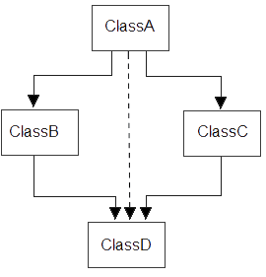
Solution to ambiguity problem during hybrid( or multipath inheritance) Virtual Base Class
Virtual base class can be used to remove the ambiguity problem
It will create a virtual path from grandparent class to the child class, so that only one copy of grandparent’s member is available in the child class, hence ambiguity is resolved.
In the following diagram we have a virtual path from Class A to Class D, hence single copies of Class A members will be available in Class D.

Slide 44
Program-Ambiguity problem in hybrid inheritance
class DB2: public B
{
protected:
int z;
public:
void get_dataDB2()
{
cout<<"\n Enter value of z:";
cin>>z;
}
};
class D:public DB1,public DB2
{
public:
void sum()
{
int result;
result=x+y+z;
cout<<"\n Result is:"<<result;
}
};
int main()
{
D obj1;
obj1.get_dataB();
obj1.get_dataDB1();
obj1.get_dataDB2();
obj1.sum();
return 0;
}
#include<iostream>
using namespace std;
class B
{
protected:
int x;
public:
void get_dataB()
{
cout<<"\n Enter value of x:";
cin>>x;
}
};
class DB1:public B
{
protected:
int y;
public:
void get_dataDB1()
{
cout<<"\n Enter value of y:";
cin>>y;
}
};

Slide 45
Virtual Base Class(Solution)-Ambiguity problem in hybrid inheritance
class DB2: public virtual B
{
protected:
int z;
public:
void get_dataDB2()
{
cout<<"\n Enter value of z:";
cin>>z;
}
};
class D:public DB1,public DB2
{
public:
void sum()
{
int result;
result=x+y+z;
cout<<"\n Result is:"<<result;
}
};
int main()
{
D obj1;
obj1.get_dataB();
obj1.get_dataDB1();
obj1.get_dataDB2();
obj1.sum();
return 0;
}
#include<iostream>
using namespace std;
class B
{
protected:
int x;
public:
void get_dataB()
{
cout<<"\n Enter value of x:";
cin>>x;
}
};
class DB1:public virtual B
{
protected:
int y;
public:
void get_dataDB1()
{
cout<<"\n Enter value of y:";
cin>>y;
}
};

Slide 46
Function Overriding
When function with same signature(or prototype) is redefined in the derived class [i.e. Base and derived class have same function], then on accessing the same function with the object of derived class, always derived class version of that function will be called, as it will override( or hide) the base class function
If we want to access the base class version of that function, then it can be accessed with the help of base class name and scope resolution operator used with the derived class object.
<derived_object>.<base_Class_name>::<function_name>(<parameters if required>);

Slide 47
Program-Function overriding
#include<iostream>
using namespace std;
class A
{
public:
void show()
{
cout<<"\nIn Base Class A";
}
};
class B:public A
{
public:
void show()
{
cout<<"\nIn Derived Class B";
}
};
int main()
{
B obj1;
obj1.show(); //Derived class show() will be called
//obj1.A::show();
return 0;
}

Slide 48
INHERITANCE
Order of execution of constructor and destructor during inheritance

Slide 49
Basic points[Order of execution of constructor and destructor during inheritance ]
If a constructor is defined in the base class and derived class, then on creating the object of derived class, base class constructor will be executed first, then derived class constructor will be called.
Order of execution of destructor will be in reverse order as that of the order of execution of constructor
If a base class is having default constructor, then it is optional for derived class to have a default constructor
If a base class is having parameterized constructor, then it is mandatory for derived class to have a parameterized constructor which will pass the parameters to the base class constructor through initializer list.

Slide 50
Order of execution of constructor and destructor during single inheritance[Default constructor in both classes]
#include<iostream>
using namespace std;
class A
{
public:
A()
{
cout<<"\nCalling default base class constructor";
}
~A()
{
cout<<"\nCalling base class destructor";
}
};
class B:public A
{
public:
B()
{
cout<<"\n Calling default derived constructor";
}
~B()
{
cout<<"\nCalling derived class destructor";
}
};
int main()
{
B obj1;
return 0;
}
Output:
Calling default base class constructor
Calling default derived constructor
Calling derived class destructor
Calling base class destructor

Slide 51
Order of execution of constructor and destructor during single inheritance[Parameterized constructor in both classes]
class B:public A
{
int l;
public:
B(int p):A(p)
{
l=p;
cout<<"\nCalling derived class parameterized:"<<l;
}
~B()
{
cout<<"\nCalling derived class destructor";
}
};
int main()
{
B obj2(1);
return 0;
}
Output:
Calling base class parameterized 1
Calling derived class parameterized: 1
Calling derived class destructor
Calling base class destructor
#include<iostream>
using namespace std;
class A
{
int x;
public:
A(int a)
{
x=a;
cout<<"\nCalling base class parameterized "<<x;
}
~A()
{
cout<<"\nCalling base class destructor";
}
};

Slide 52
Order of execution of constructor and destructor during single inheritance[Parameterized and default constructor in both classes]
#include<iostream>
using namespace std;
class A
{
int x;
public:
A()
{
cout<<"\nCalling base class default";
}
A(int a)
{
x=a;
cout<<"\nCalling base class parameterized "<<x;
}
~A()
{
cout<<"\nCalling base class destructor";
}
};
class B:public A
{
int l;
public:
B()
{
cout<<"\nCalling derived class default";
}
B(int p):A(p)
{
l=p;
cout<<"\nCalling derived class parameterized:"<<l;
}
~B()
{
cout<<"\nCalling derived class destructor";
}
};
int main()
{
//B obj1; //Either default/ or parameterized constructor can be called
B obj2(1);
return 0;
}

Slide 53
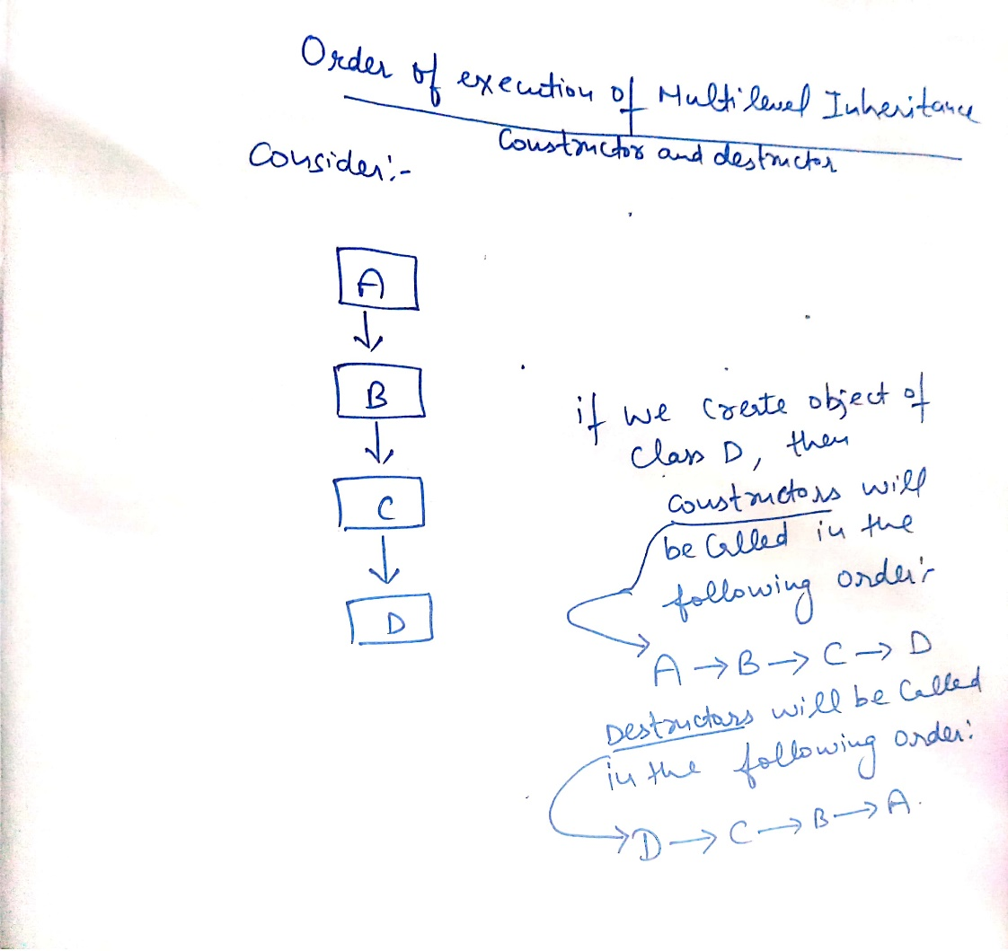
Order of execution of constructor and destructor during Multilevel inheritance

Slide 54
Program-Order of execution of constructor and destructor during Multilevel inheritance
#include<iostream>
using namespace std;
class A
{
int x,y;
public:
A(int r,int s)
{
x=r;
y=s;
cout<<"\nCalling base class constructor:"<<x<<" "<<y;
}
~A()
{
cout<<"\nCalling base class destructor";
}
};
class B:public A
{
int l,m;
public:
B(int p,int q,int r,int s):A(r,s)
{
l=p;
m=q;
cout<<"\nCalling derived class B constructor:"<<l<<" "<<m;
}
~B()
{
cout<<"\nCalling derived B class destructor";
}
};

Slide 55
Program-Order of execution of constructor and destructor during Multilevel inheritance….Continued
class C:public B
{
int n,m;
public:
C(int u,int v,int p,int q,int r,int s):B(p,q,r,s)
{
n=u;
m=v;
cout<<"\nCalling derived class C constructor with values:"<<n<<" "<<m;
}
~C()
{
cout<<"\nCalling derived class C destructor";
}
};
int main()
{
C obj1(1,2,3,4,5,6);
return 0;
}

Slide 56
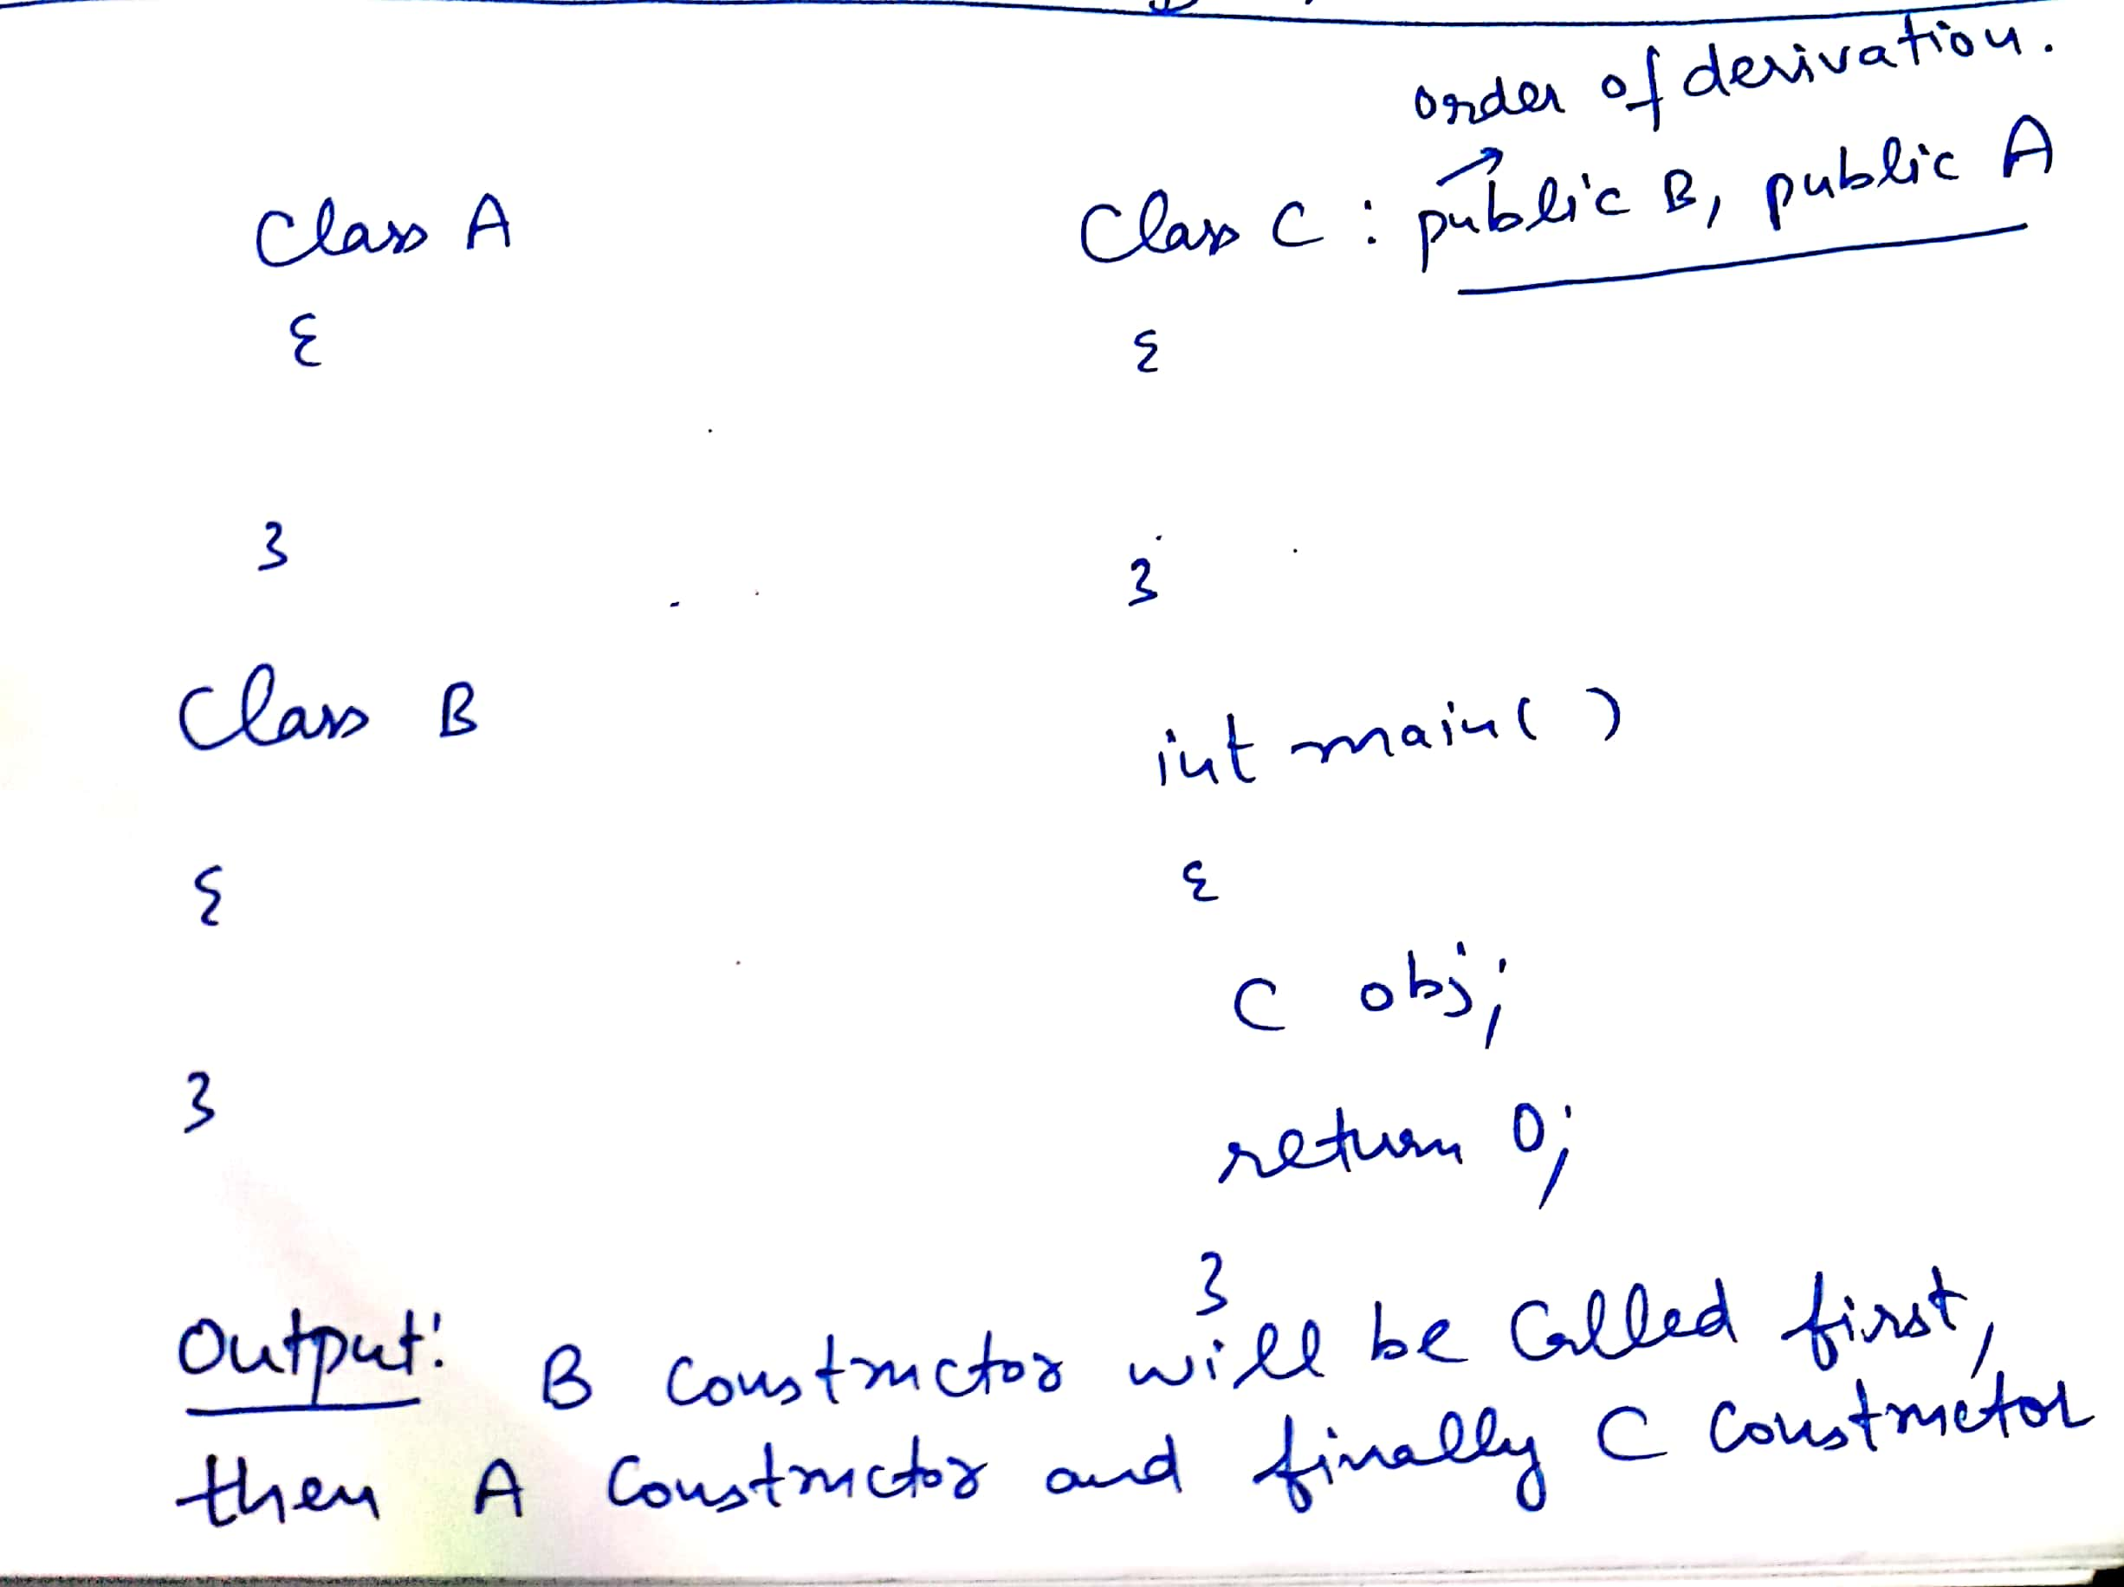
Order of execution of constructor and destructor during Multiple inheritance
Order of execution of constructor during multiple inheritance is dependent upon the order of derivation(or order of inheritance).
Order of execution of destructor will be reverse as that of order of execution of constructor

Slide 57
Order of execution of constructor and destructor during Multiple inheritance…continued…
Class A:public B, virtual C
{
};
Order of execution of constructor
//C() virtual base
//B() ordinary base
//A() derived
If one of the class is inherited in virtual mode, then constructor of that will be executed first and then order of inheritance will be followed and if both are derived in virtual mode, then order of inheritance will be followed(as usual)

Slide 58
Program-Order of execution of constructor and destructor during Multiple inheritance
#include<iostream>
using namespace std;
class M
{
protected:
int m;
public:
M(int x)
{
m=x;
cout<<"\nIn M";
}
};
class N
{
protected:
int n;
public:
N(int y)
{
n=y;
cout<<"\nIn N";
}
};
class P:public M,public N
{
int l;
public:
P(int p,int q,int r):M(r),N(q)
{
l=p;
cout<<"\nIn P";
}
void display()
{
cout<<“\n”<<"m="<<m<<" "<<"n="<<n<<" "<<"l="<<l;
}
};
int main()
{
P obj1(3,2,1);
obj1.display();
return 0;
}
Output:
In M
In N
In P
m=1 n=2 l=3

Slide 59
Order of execution of constructor and destructor during hierarchical inheritance
#include<iostream>
using namespace std;
class M
{
protected:
int m;
public:
M(int x)
{
m=x;
cout<<"\nIn M";
}
};
class N:public M
{
protected:
int n;
public:
N(int y):M(y)
{
n=y;
cout<<"\nIn N";
}
};
class P:public M
{
int l;
public:
P(int p):M(p)
{
l=p;
cout<<"\nIn P";
}
};
int main()
{
N obj1(1);//Output In M,In N
P obj2(2);//Output In M,In P
return 0;
}

